Slide 1
Collaborative Offloading for Distributed Mobile-Cloud Apps
Hillol Debnath, Giacomo Gezzi*, Antonio Corradi*,
Narain Gehani, Xiaoning Ding, Reza Curtmola, Cristian Borcea
Department of Computer Science
New Jersey Institute of Technology
*Department of Computer Science and Engineering
University of Bologna

Slide 2
Computation Offloading
Mobile devices have limited resources
Systems designed to offload resource-demanding tasks to cloud
Use cost function to balance cost and benefit of offloading a task based on:
  Workload of the task, state of resources, software and hardware dependencies
Existing works applicable only for single mobile-cloud pair
No existing work is designed to work with a distributed app
  Local offloading decisions do not always result in the best performance
  Offloading needs to be coordinated among the participating entities for best performance

Slide 3

Motivating Example
Offloading decisions can be made collaboratively to reduce overall computation latency
App: J1 -> J2
J2 must execute on D2 for privacy reasons
Scenario 1: J1 offloaded to cloud
  App completion time: 20 + 4 + 200 + 10 = 234
Scenario 2: no offloading and WiFi communication
  App completion time: 60 + 10 + 10 = 80
Complexity increases when there is dependency on devices and other computations
J2
10
J1
60
D2
10
D1
200
20
4
J1
Cloud Services

Slide 4
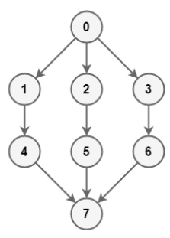
Distributed Mobile-Cloud Apps and Jobs
Distributed apps run over heterogeneous devices
A distributed app comprises of a set of jobs
  Job represents a code component (e.g., class, function, etc.)
Jobs can be dependent on devices
  Can depend on sensors or private data located on a device
Jobs can be dependent on other jobs (e.g., precedence constraints)
  Dependency can be modeled as a directed acyclic graph

Slide 5
Challenges
Scheduling jobs
  How to determine what (which job) to offload and where?
  Static Partitioning
    Offloading decision is static and predefined
      Some jobs are pre-configured to run on mobile or cloud
  Dynamic Partitioning
    Offloading decision is dynamic and made during runtime
      Jobs and resources are analyzed during runtime
Difficult to generate a schedule of jobs. For n jobs, m devices:
  Exponential search space: m^{n} number of <device, job> combinations
  NP-hard problem
Difficult to efficiently execute jobs according to the schedule

Slide 6
CASINO Overview
Dynamic and collaborative offloading framework for distributed mobile-cloud apps
CASINO’s job scheduler
  Works in real-time
  Considers global resource conditions and job/device dependencies
  Generates a job schedule for a distributed app that minimizes the app completion time
Deployment framework profiles resource information from participating devices to help the job scheduler
Programming framework provides simple API that can be used by programmers to partition apps statically and dynamically
Prototype implemented on Android mobiles and Android X86 virtual machines

Slide 7
Outline
Introduction
Framework Design
Job Scheduling
Scheduling Validation
Prototype Implementation
Experimental Evaluation
Conclusion

Slide 8






Leveraging Avatar Platform for CASINO
Avatar Platform
  Each mobile device has an associated avatar (e.g., VM) in the cloud
  Avatars execute app components on behalf of users’ mobile devices
Apps running on Avatar platform have
  Low latency/response time
  Energy efficiency
  High availability
avatar3
avatar1
avatar4
avatar2
Cloud
Mobiles and avatars of users participating in a distributed app form the set of machines for scheduling

Slide 9
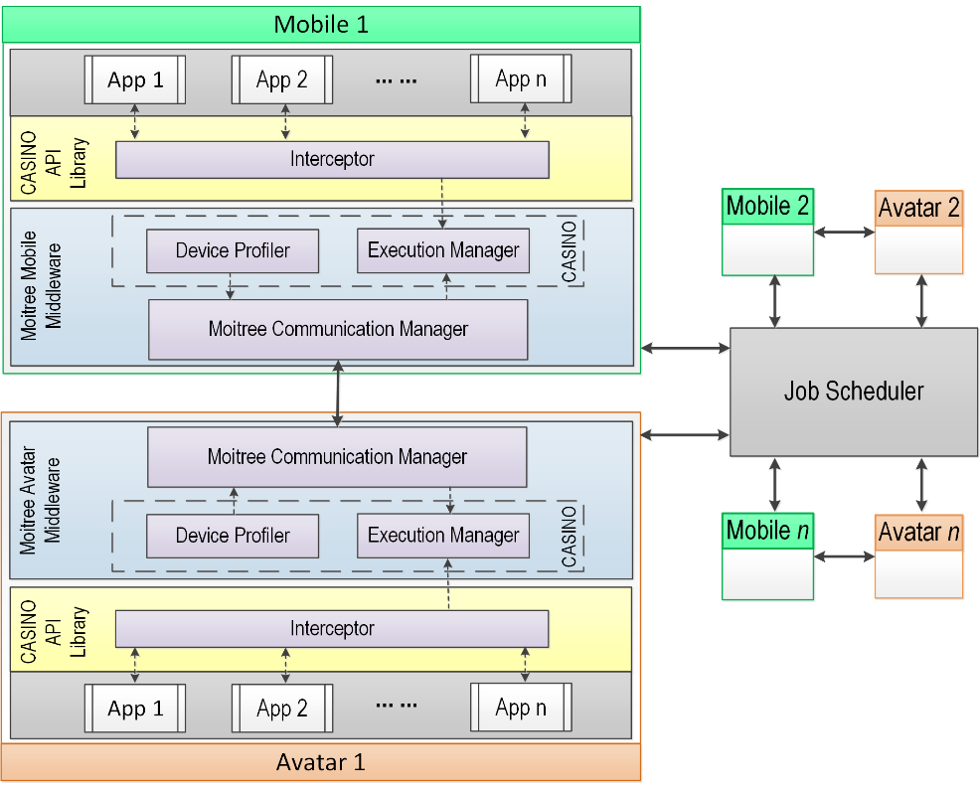
Framework Design (1)
Works on top of Moitree, the Avatar platform’s middleware
Has components at mobiles and
avatars
Simple annotation based API
  API library linked to apps
  Code components annotated with
    @Local or @Remote for static partitioning
    @Offloadable for dynamic partitioning
  Code interceptors analyze annotations

Slide 10
Framework Design (2)
Job Scheduler is a cloud service
  Maintains a job queue
  Uses global resource conditions
  Resolves job/device dependencies
  Schedules jobs
Device profilers
  Profile CPU, memory, network
  Send profiling data to job scheduler
Execution manager
  Receives jobs assigned by scheduler
  Executes scheduled jobs
  Synchronizes state needed for offloading

Slide 11
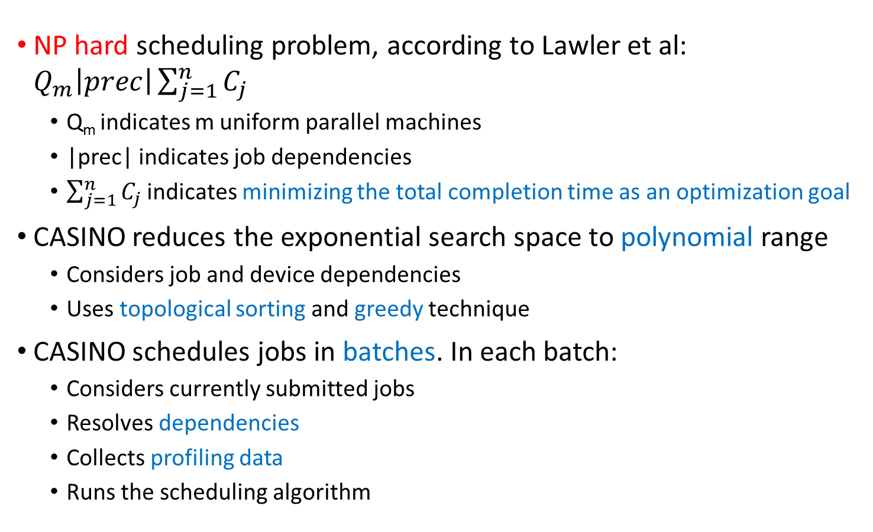
Job Scheduling
NP hard scheduling problem, according to Lawler et al: $Q_{m}\left|prec\right|\sum_{j=1}^{n}{C_{j}}$
  Q_{m} indicates m uniform parallel machines
  |prec| indicates job dependencies
  $\sum_{j=1}^{n}{C_{j}}$ indicates minimizing the total completion time as an optimization goal
CASINO reduces the exponential search space to polynomial range
  Considers job and device dependencies
  Uses topological sorting and greedy technique
CASINO schedules jobs in batches. In each batch:
  Considers currently submitted jobs
  Resolves dependencies
  Collects profiling data
  Runs the scheduling algorithm

Slide 12
Scheduling Algorithm
procedure schedule(J, M, E, R)
L ← topologicalSort(E)
COMP[][]← estimateComputationCost(L,M)
totalCost ← 0
for each job j in L
if j is dependent on device d then
schedule j on device d
calculate (comm+comp) cost for j on d
update totalCost
continue
for each device x in M
estimate cost of executing j on x
schedule j on the min cost device
update totalCost
return schedule s
end procedure
Time complexity: O(mn²logm)

Slide 13
Validation of the Job Scheduler (1)
Validated using simulated but realistic data
Device dependency matrix
Job dependency matrix
J₀
J₁
J₂
J₃
J₄
J₅
J₆
J₇
J₀
J₁
J₂
J₃
J₄
J₅
J₆
J₇
M₀
J₀
M₁
J₁
M₂
J₂
Av₀
J₃
Av₁
J₄
Av₂
J₅
J₆
J₇

Slide 14
Validation of the Job Scheduler (2)
M₀
M₁
M₂
Av₀
Av₁
Av₂
M₀
M₁
M₂
Communication cost matrix based on typical WiFi/cellular latency
Av₀
Av₁
Av₂
J₀
J₁
J₂
J₃
J₄
J₅
J₆
J₇
M₀
M₁
M₂
Computation cost matrix estimated
based on instructions counts
Av₀
Av₁
Av₂

Slide 15
Results
J₀
J₁
J₂
J₃
J₄
J₅
J₆
J₇
M₀
Ordered list of jobs:
[J_{0,} J_{1,} J_{2,} J_{3,} J_{4,} J_{5,} J_{6,} J₇ ]
M₁
M₂
Av₀
Av₁
Av₂
Generated Schedule
Total completion time
  Everything on mobile: 3416 ms
  Everything on avatars: 1837 ms
  Scheduled by CASINO: 1614 ms
Validation shows the capability of dynamic partitioning

Slide 16
Outline
Introduction
Framework Design
Job Scheduling
Scheduling Validation
Prototype Implementation
Experimental Evaluation
Conclusion

Slide 17
CASINO Implementation
Prototype build for Android devices and Android x86 virtual machines
CASINO software and apps run as different processes
  Android’s Binder interface used for Inter-Process Communication
CASINO uses AspectJ and Java’s annotation processing
  AspectJ injects code for processing annotations during compile time
  Alternatively, Java Dynamic Proxy mechanism was tested
    Works at run-time, uses Java reflection
    Slow, more overhead

Slide 18
Profiler Implementation
CASINO profiles system resources on each device
Network profiler uses Android’s NetworkInfo and TrafficStats API
CPU and memory profiler reads native system files for getting capability and usage
    "/proc/stat“ and “/sys/devices/system/cpu/…”
Battery profiler uses a combination of Android API and reading native system files
    Android’s BatteryManager API
    Reads “/sys/class/power_supply”
Other tools such as Battery Historian, Network Monitor, and HPROF Analyzer were used to analyze resource usage

Slide 19
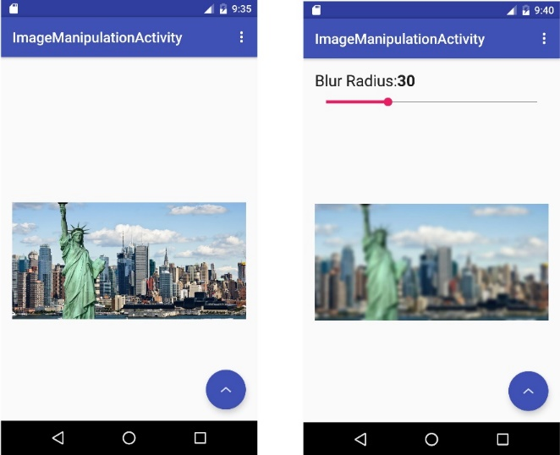
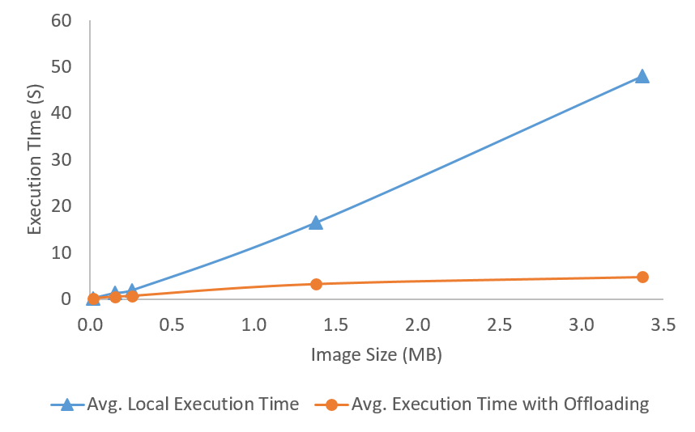
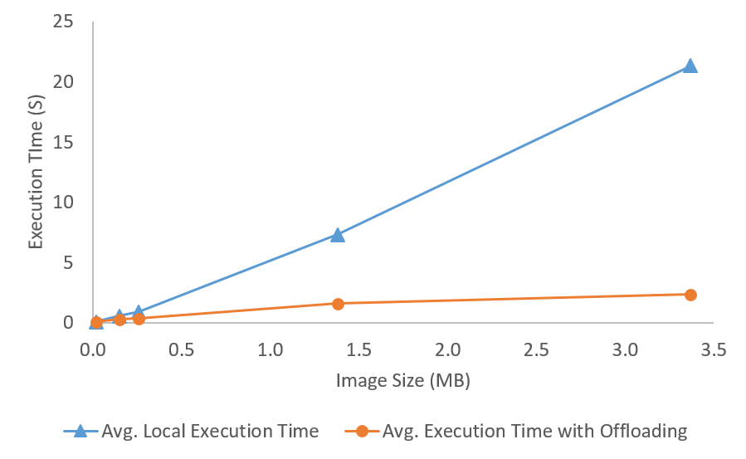
Evaluation of Photo Filtering App
Applies Gaussian blur filter on a photo
The filtering job is annotated with @offloadable
Tested for one mobile-cloud pair
Tested with both Java and native C++ implementation of the filter
Dynamic offloading improves execution time substantially
  Benefits of offloading increase with image size
Java based implementation of the filter
C++ implementation of the filter

Slide 20
Evaluation of Execution Manager
State Size (Kb) | Execution Time Including Offloading (ms) | Overhead – Interception and State Initialization (ms) | Overhead – State Sync (ms) | Overhead Percentage
237.31 | 3212 | 2.11 | 0.06 | 0.06%
61.36 | 664 | 2.75 | 0.07 | 0.40%
36.44 | 490 | 2.93 | 0.08 | 0.61%
6.70 | 145 | 2.79 | 0.06 | 1.97%
Overhead is low and remains below 2%
Overhead percentage decreases as the state size increases

Slide 21
Conclusion
The first computation offloading framework for distributed apps running on mobile-cloud platforms
CASINO provides an API for both static and dynamic partitioning of code
We designed a job scheduler for minimizing the total completion time
  Polynomial time approximation algorithm for an NP-hard problem
  All jobs are scheduled according to their constraints
We designed and implemented in Android a development and deployment framework that performs efficiently

Slide 22
Thanks!
http://cs.njit.edu/~borcea/avatar
Acknowledgment: NSF Grants No. CNS 1409523, CNS 1054754, DGE 1565478, and SHF 1617749; DARPA/AFRL Contract No. A8650-15-C-7521

