Slide 1
Sentio: Distributed Sensor Virtualization for Mobile Apps
Hillol Debnath, Narain Gehani, Xiaoning Ding, Reza Curtmola, Cristian Borcea
^{Department of Computer Science}
New Jersey Institute of Technology

Slide 2
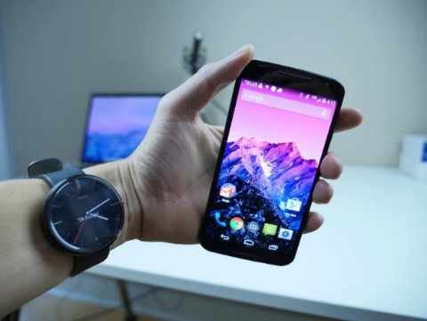
Goal: Mobile Apps Access Distributed Sensors Seamlessly
Mobile apps running on a device may need to
  Access sensors on other devices in real-time (e.g., mobile health, mobile gaming)
    Sensor fusion
    Cross-validation of data
    Choosing “best” sensor when several sensors of same type are available
  Access sensors from cloud when app components are offloaded
Existing mobile sensing frameworks do not provide these features
  Difficult for apps to leverage the collective power of sensors on other devices
  Limited benefits from offloading context-aware apps that need sensor access

Slide 3
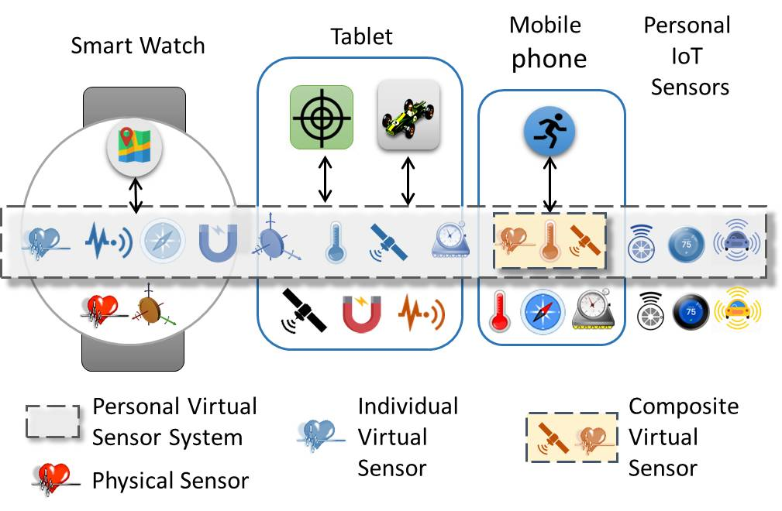
Sentio: High-Level View
Distributed middleware that presents mobile apps with a personal virtual sensor system (PVSS)
PVSS comprises of all available sensors from all devices (mobiles and IoT) belonging to the user running the app
  Public sensors belonging to other entities can become part of PVSS

Slide 4
Sentio: Features
Common API for apps no matter where they run
  Offers support for creating individual and composite virtual sensors
  Provides access to virtual sensors in the same way with access to local sensors
  Allows programmers to specify a sensing mode, and then map the virtual sensor to the most suitable physical sensor for that mode
    Modes: accuracy, real-time, energy efficiency
Middleware hides low-level communication and sensor management
  Supports real-time access to remote sensor data
  Maintains seamless connectivity to the physical sensor even after offloading app components to the cloud
  Adapts to context changes by re-mapping a virtual sensor to a more suitable physical sensor
  Does not require modifications to operating system

Slide 5
Comparison with Related Work

Slide 6
Outline
Introduction
Programming with Sentio’s API
Middleware Design
Prototype Implementation
Experimental Evaluation
Conclusion

Slide 7
Programming with Sentio’s API
API follows an event-driven and callback-based asynchronous design
For each API function, the app needs to provide a callback function
An API call sends a request and returns immediately
The middleware handles the request and returns the sensing data to the app by invoking the callback function
Implementing a sensor listener callback

Slide 8
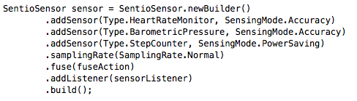
Building a Composite Sensor
Composite sensor for climbing combines readings from:
  Most accurate Heart Rate Monitor and Barometric pressure sensor in PVSS
  Most energy-efficient Step Counter sensor in PVSS
  A custom fuse action is implemented by the programmer
Warn mountain climbers when they should rest or drink more water at high altitude

Slide 9
Middleware Architecture
Distributed middleware: instances run on every participating device
    Manages sensor registration, data collection, sensor mapping
Instance in the cloud maintains global registry and sensor state
  Ad hoc networking is used for failover: primary device (smart phone) periodically synchronizes with the cloud instance to be able to take over in case of failures

Slide 10
Middleware Design

Slide 11
Design Details
Sensor discovery is done during initialization
  Each instance builds local registry
  Cloud instance maintains global registry
If app does not specify a sensing mode, Sentio makes the selection by balancing accuracy, latency, and power
To reduce jitter, rate controller buffers data points arriving early and uses extrapolation to project data points that arrive late
If context changes (e.g., low battery) in sensing provider device
  Instance in provider raises an alert event
  Instance in consumer device re-maps virtual sensor to another suitable sensor

Slide 12
Prototype and Apps
Implemented for Android and Android Wear OS
  3,127 LoC for the SDK
  3,726 LoC for the Android middleware
  561 additional LoC for the Android Wear middleware
Implemented two proof-of-concept apps (SentioApp and SentioFit)
Modified two open source games (Space Shooting and Tilt Control) to use Sentio API
  Only 6 LoC needed to be modified to use remote accelerometer on smart phone or smart watch
Tested using Nexus 6, Nexus 5X, Moto X smart phones and Samsung Gear Live smart watch
Bluetooth and WiFi used for data communication
Android x86 64-bit VM is used as the cloud entity

Slide 13
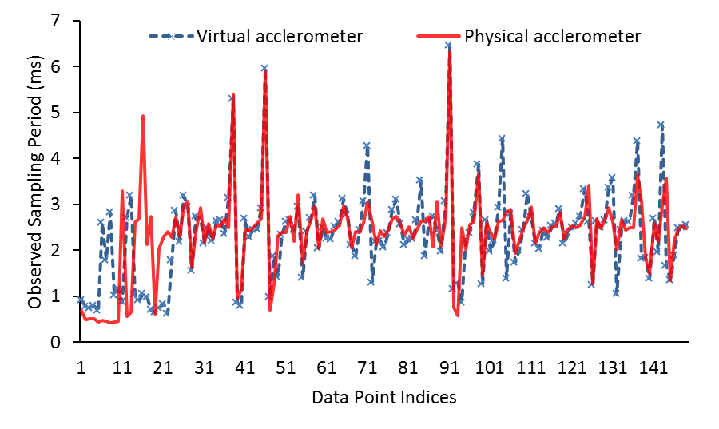
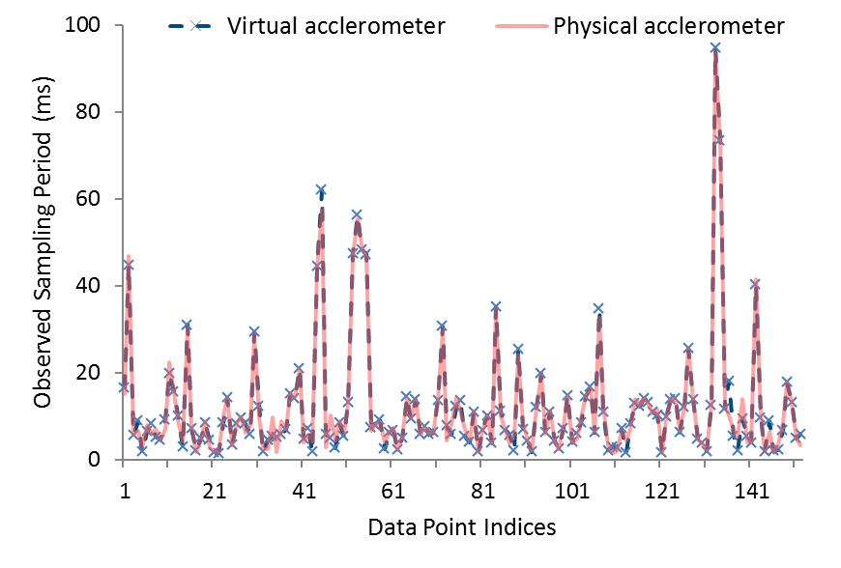
Sentio Overhead
Physical sensor on a phone
Physical sensor on a watch
Measured the difference between the observed sensor sampling period for virtual and physical accelerometer for Space Shooting game
  Metric quantifies Sentio’s overhead
  Communication is done over WiFi
The results show minimal overhead

Slide 14
Sentio Overhead for Offloaded Computation
Measured observed sampling period when Tilt Control game is offloaded to the cloud
Accessing sensors from cloud works well
  The difference in sampling periods is negligible for all sampling rates, except Fastest
  The difference for Fastest is 5.32ms, which is acceptable in most practical situations

Slide 15
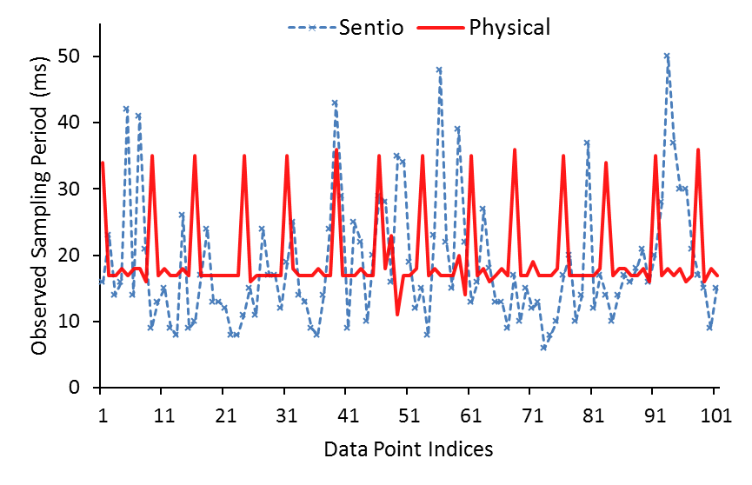
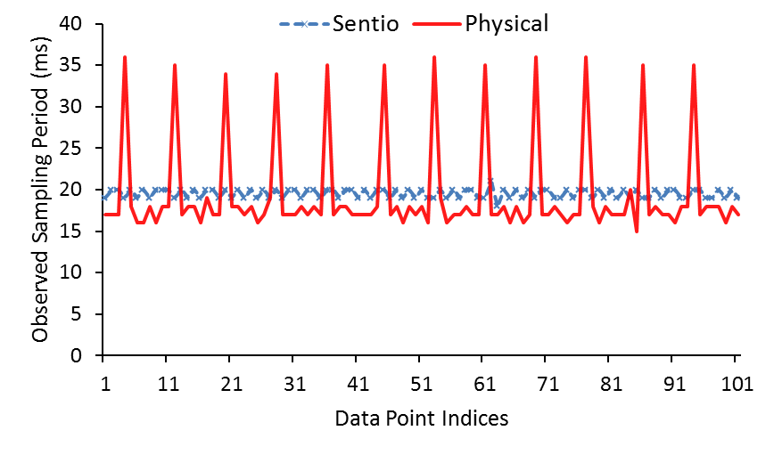
Jitter
Without data rate controller
With data rate controller
Virtual accelerometer is mapped to another phone
Data rate controller reduces the jitter significantly

Slide 16
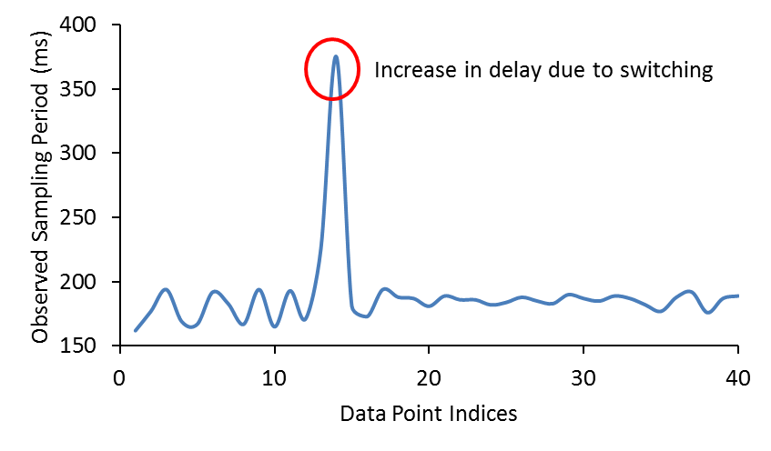
Cost of Re-mapping Virtual Sensor
Virtual magnetic field sensor re-mapped from smart watch to smart phone
The increase only affects the immediately next data point after switching
For all practical purposes, skipping one data point is acceptable
  Data rate controller could smoothen this problem
  Context prediction can enable proactive switching

Slide 17
Conclusion
Sentio provides a unified view of a personal sensing ecosystem
Sentio enables new, distributed, efficient, context-aware mobile apps
Apps can use Sentio API to
  Access virtual sensors in real-time
  Access the ‘best’ sensor of a particular type
  Build composite virtual sensors
Sentio middleware
  Transparently re-maps virtual to physical sensors during context changes
  Provides seamless sensor connectivity for offloaded code
Built prototype in Android and demonstrated low overhead and low latency for apps with tight real-time constraints

Slide 18
Thanks!
http://cs.njit.edu/~borcea/avatar
Acknowledgment: NSF Grants No. CNS 1409523, CNS 1054754, DGE 1565478, and SHF 1617749; DARPA/AFRL Contract No. A8650-15-C-7521

