Slide 1
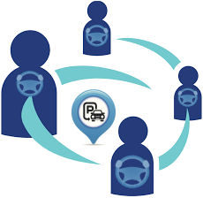
Cooperative System for Free Parking Assignment
Abeer Hakeem, Narain Gehani, Xiaoning Ding, Reza Curtmola, Cristian Borcea
^{Department of Computer Science}
New Jersey Institute of Technology

Slide 2
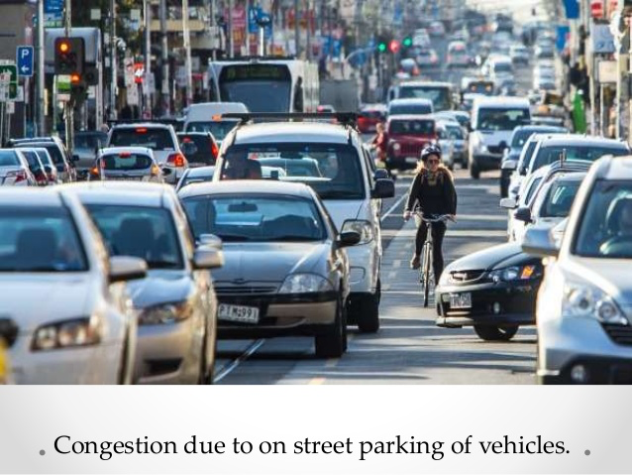
Have You Ever Spent Hours Driving Around the Block for a Free Parking Space?
Many cities rely on free curbside parking spaces to supplement their limited paid parking options
People prefer free curbside parking to save money
Cost of cruising for curbside parking spaces
Billions of hours lost to find available spaces during peak periods
Billions of gallons of gasoline wasted
Air pollution and noise
Traffic congestion and driver frustration

Slide 3
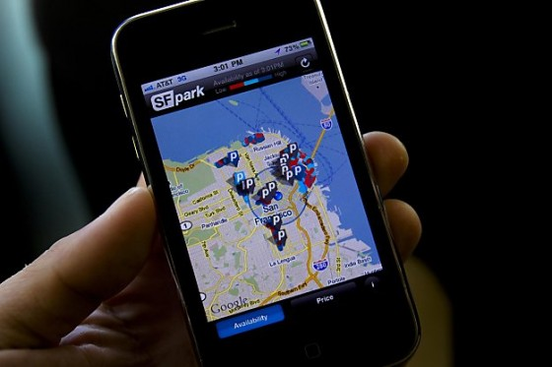
Parking Infrastructure Solutions
Examples
SFpark system spent $23 million to install sensors to cover 25% of the curbside parking spaces
ParkNet system uses vehicles equipped with ultrasonic range finders to detect available spaces
Problems with parking infrastructure solutions
Cost
Parking space contention and higher traffic
congestion

Slide 4
Our Prior Work
FPS is a centralized system for assigning free curbside parking spaces to drivers
FPS Problems
Scalability
Scalability
Privacy
Decentralized Solution
Focus of this work
DFPS

Slide 5
DFSP Overview
Decentralized system for assigning free parking spaces to drivers
Two components: mobile app running on drivers’ smart phones and dispatcher running at a central server
Accepts parking requests on-the-fly
Receives parking occupancy reports from drivers
Can take advantage of any system that reports parking availability
Parking assignment optimizes travel time as a system wide objective
Assumes that not all drivers participate in our system
Solves the scalability problem in FPS
Removes computation from dispatcher: offloads parking assignment to the smart phones of drivers
Reduces communication at dispatcher: uses a structured overlay network to organize the cooperative drivers

Slide 6
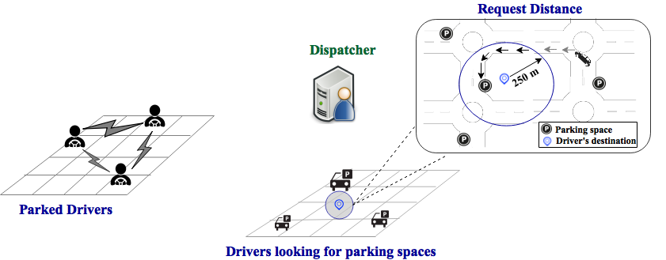
DFPS Design
Dispatcher:
Runs at central server
Serves as bootstrapping unit
Receives parking requests and forwards them to the cooperative drivers
Parking Request
Parking Request
Assigned Parking Space
Apps of parked drivers:
Handle the forwarded parking requests from the dispatcher
Manage the parking space availability in different regions
Assign available spaces to drivers
Apps of drivers looking for spaces:
Submit parking requests
Guide driver to the assigned parking space

Slide 7
Overlay Network
Requirements
Scalability: system works efficiently for large numbers of drivers
Load Balancing: drivers share evenly parking assignment workload for different geographic regions
Fast Routing: requests forwarded to the parked drivers managing the target regions with low-latency
Adaptability: system adapts to high churn (parked drivers coming and going frequently)
Solution: parked drivers form K-D tree overlay that satisfies the requirements
K-D tree: space partitioning data structure for organizing data points (i.e., regions) in a space with K-dimensions
Each parked driver manages parking assignment for a region

Slide 8
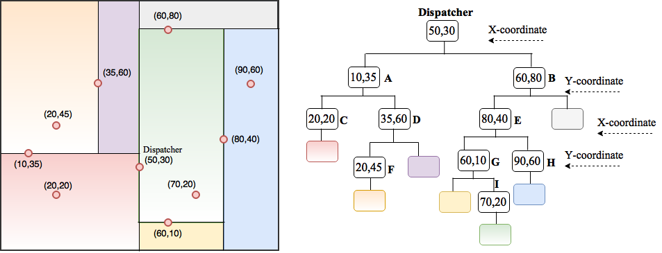
K-D Tree Representation in DFPS
B
D
H
F
A
I
C
G
Dispatcher is root node
Each tree node (parked driver) represents a region
Node’s value is location of parked driver
Parking spaces in a region are represented as data points
Space partitioned along x and y axis in an alternative fashion

Slide 9
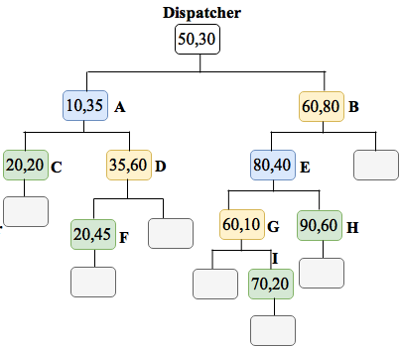
Parked Drivers Roles in K-D Tree
B
D
H
F
A
I
C
G
Region Manager
Parking Manager
Region managed by parking manager
Region and Parking Manager

Slide 10
Parking Assignment Made by Each Parking Manager
Two Free Parking Assignment (FPA) algorithms
FPA: assigns parking spaces in the region in two phases
Minimize the total walking time from the parking spaces to the drivers’ destinations by using minimum-cost network flow algorithm
Minimize the total driving time from the vehicles’ current positions to the parking spaces by using our modified compound laxity algorithm
FPA-1: enhanced FPA algorithm to consider spaces occupied by unsubscribed drivers
When a parking manager runs out of free spaces, but still has outstanding requests
Acquire spaces from nearby parking managers

Slide 11
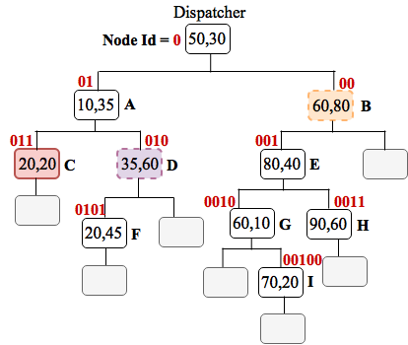
Neighbor Table
Indexing scheme to locate nearby regions of a node
Assigns a binary identifier to each node (i.e., index)
Index reflects the path from the root to the node and the location of the corresponding region
Node | Neighbors
C(011) | D(010) | B(00)

Slide 12
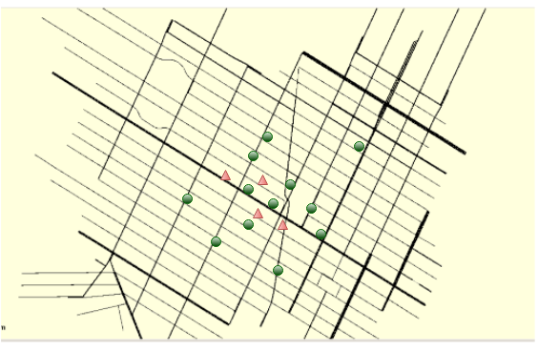
Experiments
Goals:
Quantify system scalability and load balancing
Evaluate performance of DFPS/FPA and DFPS/FPA-1 against
Naïve: assumes a breadth-first-search for parking spaces around the destinations
FPS/FPA and FPS/FPA-1
Simulation Setup:
SUMO, a simulator of urban mobility
Origins and the destinations of vehicles are randomly chosen
Each vehicle moves at the legal speed limit of each road
1024 parking spaces and 400 destinations
Destinations
Parking spaces
Road network map: Manhattan, NYC

Slide 13
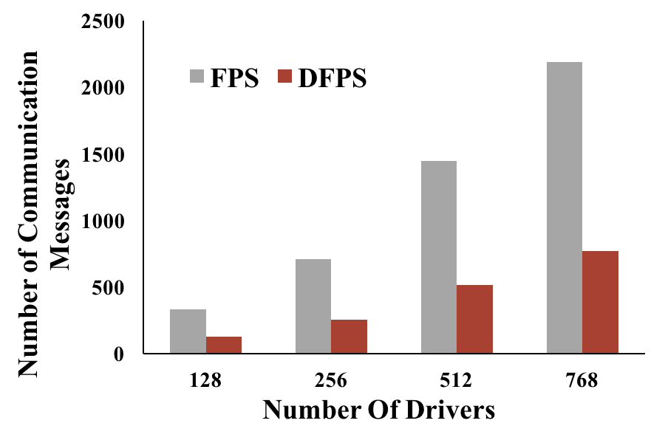
Computation and Communication Scalability
DFPS removes the computation cost at the dispatcher
Feasible to execute parking assignment on phones: O(n²+nm)+O((n+⍺)²)
Load balancing can reduce n and ⍺, and thus improves scalability
DFPS decreases the communication costs at the dispatcher by factor of 2 compared to FPS
8 destinations

Slide 14
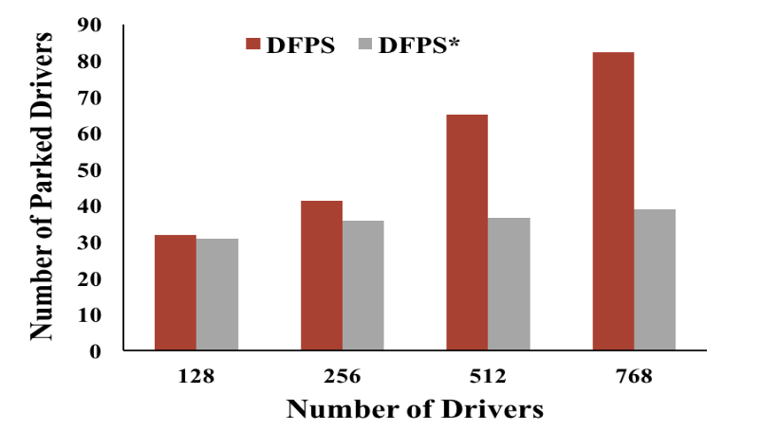
Load Balancing
K-D tree provides good load balancing
In addition, DFPS limits the number of requests processed by a parking manager
Parking manager leaves K-D tree when the limit (10 requests in experiments) is reached
Compare DFPS (with request limit) and DFPS* (without request limit)
# of requests handled by the driver with the heaviest workload
786 drivers | Destinations
 | 2 | 4 | 8
DFPS | 13 | 12 | 12
DFPS* | 268 | 166 | 100
8 destinations
DFPS avoids heavy workload on each driver
DFPS distributes the load to 185% more parking managers than DFPS*

Slide 15
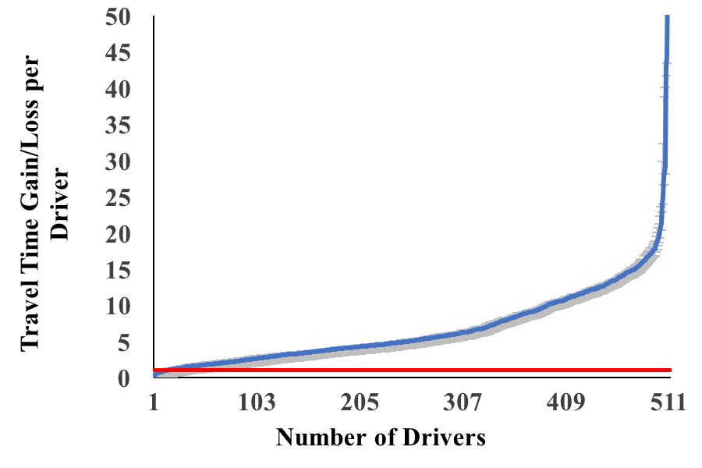
Travel Time Gain/Loss for All Drivers
Gain: ratio > 1
Loss: ratio < 1
8 destinations
=1
Travel Time Gain/Loss Ratio = $\frac{T_{i}\left(Naive\right)}{T_{i}\left(DFPS/FPA\right)}$
97% of DFPS drivers obtain gains

Slide 16
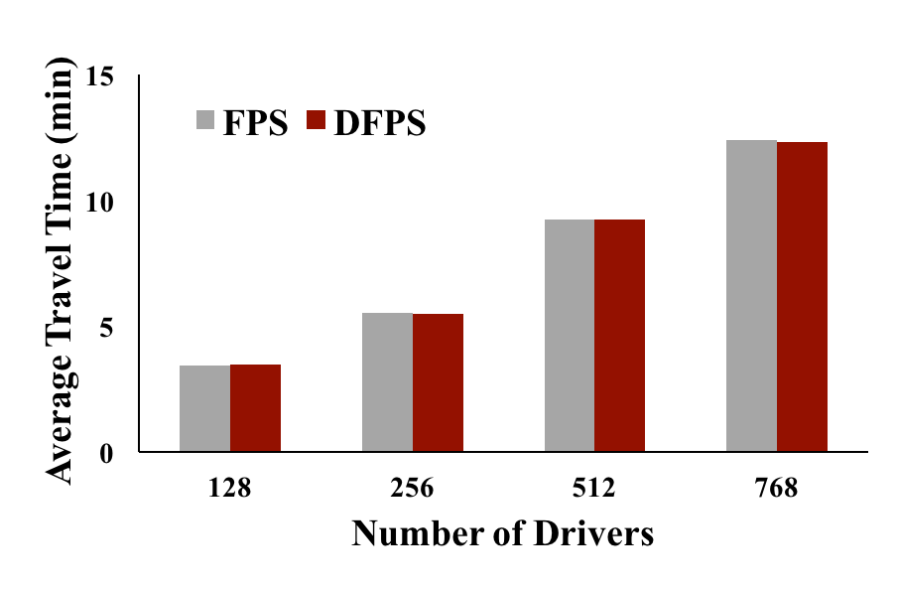
Average Travel Time: Subscribed Drivers
8 destinations
Similar to FPS, DFPS achieves good average travel time performance

Slide 17
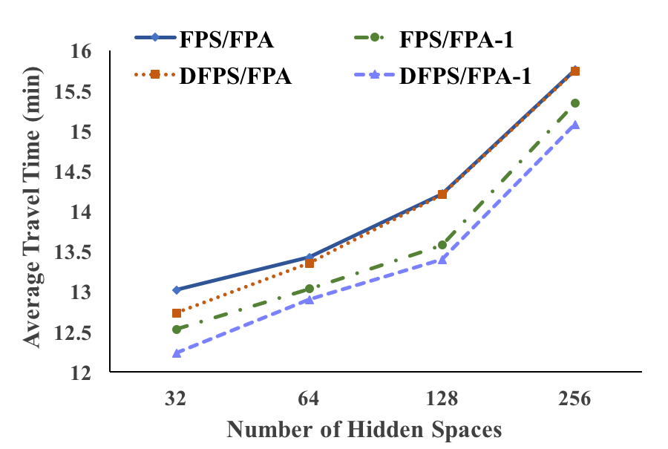
Average Travel Time: Un-subscribed Drivers
768 drivers and
8 destinations
Enhanced algorithm for assigning spaces taken by unsubscribed drivers, which are discovered in real-time, improves the travel time performance
DFPS/FPA-1 has a similar performance with FPS/FPA-1

Slide 18
Conclusion and Future Work
DFPS
Cost-effective and efficient distributed parking assignment system
Achieves good scalability and load balance
Similar travel time performance with centralized solution
Substantial decrease in travel time compared with Naïve solution
DFPS-P: privacy-aware extension of DFPS that protects driver destination from dispatcher and most of the other drivers
The effect of privacy protection on performance must be minimized

Slide 19
Acknowledgment: NSF Grants No. CNS 1409523, CNS 1054754, DGE 1565478, and SHF 1617749; DARPA/AFRL Contract No. A8650-15-C-7521

