Slide 1
Distributed Mobile Cloud Computing with Avatars
Cristian Borcea
^{Department of Computer Science}
New Jersey Institute of Technology

Slide 2

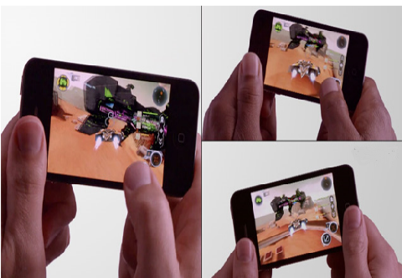

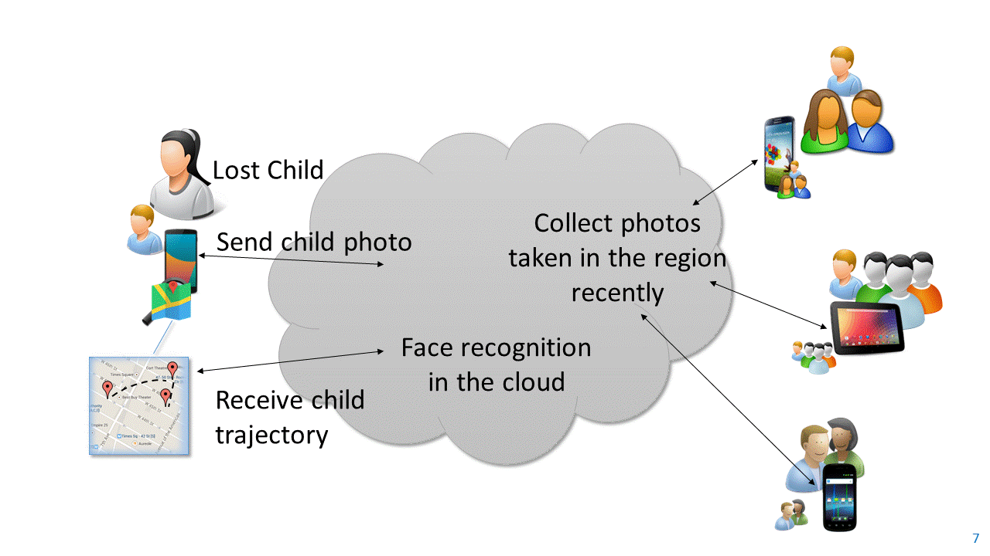
Mobile Distributed Apps Assisted by Cloud
Enable direct collaboration among mobile users
  Novel apps based on huge amounts of data generated every day by mobile/IoT devices
  Users are willing to share data with certain communities
Use cloud support for efficient/reliable execution
Examples of apps
  Healthcare and wellbeing
  Safety
  Transportation
  Collaborative sensing
  Mobile multiplayer gaming

Slide 3

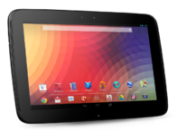
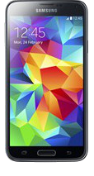



Avatar Platform for Mobile Distributed Apps
Platform
  Each mobile device has an associated avatar (e.g., VM) in the cloud
  Avatars execute app components on behalf of users’ mobile devices
Apps
  Able to use mobile sensors/files seamlessly while running in cloud
  Keep running when mobile devices are turned off or disconnected
Benefits
  Low latency/response time
  Energy efficiency
  High availability
avatar3
avatar1
avatar4
avatar2
Cloud

Slide 4
Research Directions for Avatar Platform
Distributed
Programming
Privacy
Moitree Middleware
IEEE Mobile Cloud ‘16
Privacy Preserving Face Matching
IEEE Sarnoff Symposium ‘16
Avatar Platform
CASINO Framework
IEEE Mobile Cloud ‘18
Distributed
Offloading
Mobile Sensing
File Systems
Distributed Sensor Virtualization
IEEE Percom ‘18
OFS Mobile-Cloud File System
IEEE Trans. on Cloud Computing ‘18

Slide 5
Moitree: A Middleware for Distributed Mobile-Cloud Apps

Slide 6
Programming Challenges for Avatar Platform
How to provide an API to transparently use mobile-avatar pairs in apps?
What programming abstractions are needed to write apps over distributed mobile-avatar pairs?
How to integrate dynamic context such as location, time, and social relationships into the programming abstractions?
How to offload mobile-to-mobile communication to the cloud?

Slide 7
Moitree Middleware for Avatar Platform
Provides an API that implements a high-level distributed programming model for developing Avatar apps
  Communication end-points are mapped transparently to mobile-avatar pairs
  Common app execution environment on mobiles and avatars allows seamless offloading of app components
  Context-aware group-based abstractions to manage user collaboration
  Abstract communication channels to offload mobile-to-mobile communication to the cloud

Slide 8

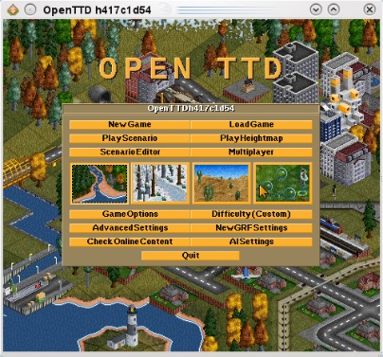
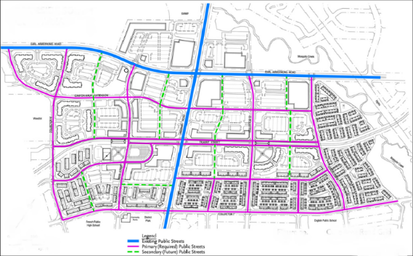
Context-aware Groups
Human collaboration breaks down into groups and sub-groups
Moitree’s programming model structures user collaboration within apps over context-aware groups
  Formed and maintained dynamically based on context parameters
  Structured hierarchically
Multiplayer gaming: group defined by players of the same instance of the game
Lost child app: group defined by location and time
(find people who took photos in this location since 1pm)
Free parking spot app: hierarchical groups of drivers (hierarchy: city, district, block, street)

Slide 9


Communication Channels
Communication channels
  Communication abstraction for group collaboration
  Mobile-mobile communication offloaded to the cloud
  Hides programming complexity for distributed communication
Four asynchronous communication channels
  broadcast
  point2point
  anycast
  scatter-gather
Request
Request
Channel in the cloud
Request
Request
Scatter-gather channel
Response
Response
Response
Channel in the cloud
Response

Slide 10
LostChild Programming in Moitree
Initiator (Parent of the lost child)
Participant
3. OnCreateGroup is called by middleware
1. Set dynamic group membership properties
searchForLostChild(){
MembershipProperties prop = new MembershipProperties();
prop.setLocationBound(LOCATION, RADIUS);
prop.setTimeBound(TIME_FROM,TIME_TO);
Group group =
Avatar.createGroup(null,prop,false,LIFETIME);
ReadCallback callback = new ReadCallback(){
public void scatterGather(ChannelID cid,Message msg){
//msg contains results sent by participants
//add result to potential trajectories
//update user with latest trajectories
if (ChildFound){
DONE=true;
}
}
... ... ... //other channel callbacks
}
group.setReadCallback(callback);
ChannelID cid = generateChannelID();
group.scatterGather(cid, childImage);
while (!DONE){ //block }
group.deleteGroup(group.credentials());
}
`
onCreateGroup(Group group){
ReadCallback callback = new ReadCallback(){
public void scatterGather(ChanelID cid, Message msg){
Image image = msg.getData();
//run face recognition with image
//if child image is recognized, set the location and time associated with the matching photo in result
group.scatterGather(cid, result);
}
... ... ... //other channel callbacks
};
group.setReadCallback(callback);
}
6. Receive image, run recognition and send back result
2. Call createGroup with the membership properties
4. Set channel callbacks
7. Receive and process recognition results
5. Send child image

Slide 11
Moitree Architecture
Mobile
Avatar
Avatar
Mobile
Mobile Distributed Applications
Mobile Distributed Applications
Moitree API
Moitree API
Moitree
Group
Related Services
Moitree Mobile Middleware
Moitree Avatar Middleware
Moitree Avatar Middleware
Moitree Mobile Middleware
Cloud

Slide 12
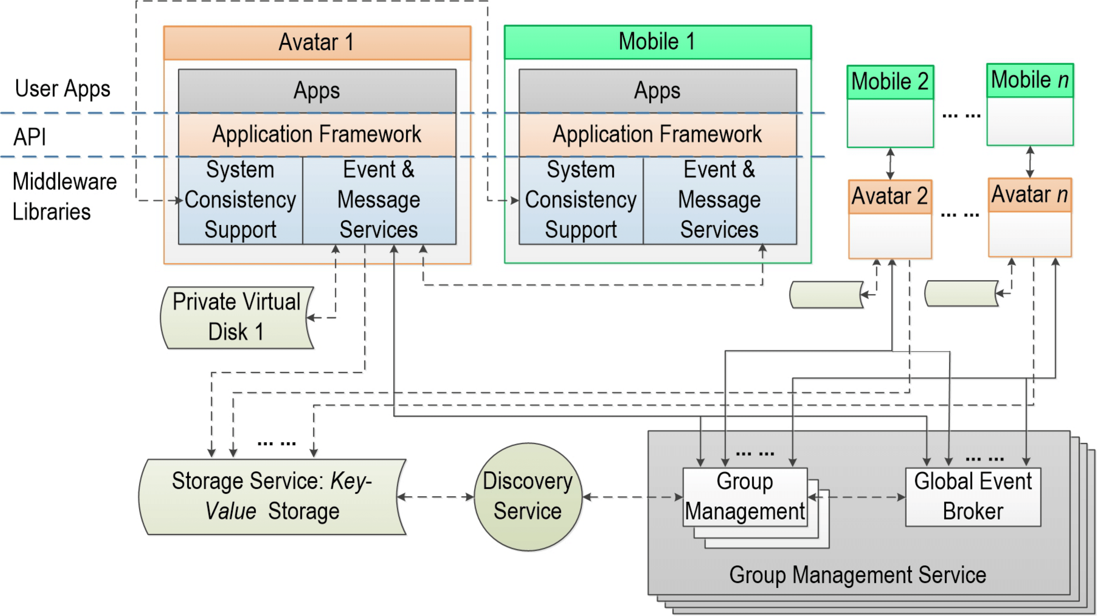
Middleware Components
Processes events and messages generated by apps
Synchronizes user generated content between mobile and avatar
Individual private avatar storage
Provides dynamic group management and group communication support
Enables context-aware group membership
Shared storage for avatars

Slide 13
Prototype Implementation
Android-based implementation
  Nexus 5 and Nexus 6 mobile devices
Built Openstack-based cloud to host avatar VMs
  Each avatar is Android-x86 VM
Implemented LostChild and FaceDate apps
  Face detection and face recognition implemented using OpenCV 2.4.10
  Number of lines of code reduced significantly when using Moitree vs. native Android implementation

Slide 14
FaceDate Overview
Enables a user to match nearby users based on their looks
Matching is done in real-time and it has to be mutual
Face recognition algorithm finds similarity between photos of persons that the user likes and profile pictures of nearby users
Profile pictures are displayed to users only when there is a match to protect user privacy
Implemented and evaluated with Android-based devices and Android x86 VMs
Results demonstrate that FaceDate is practical
  Good end-to-end latency
  Good scalability

Slide 15
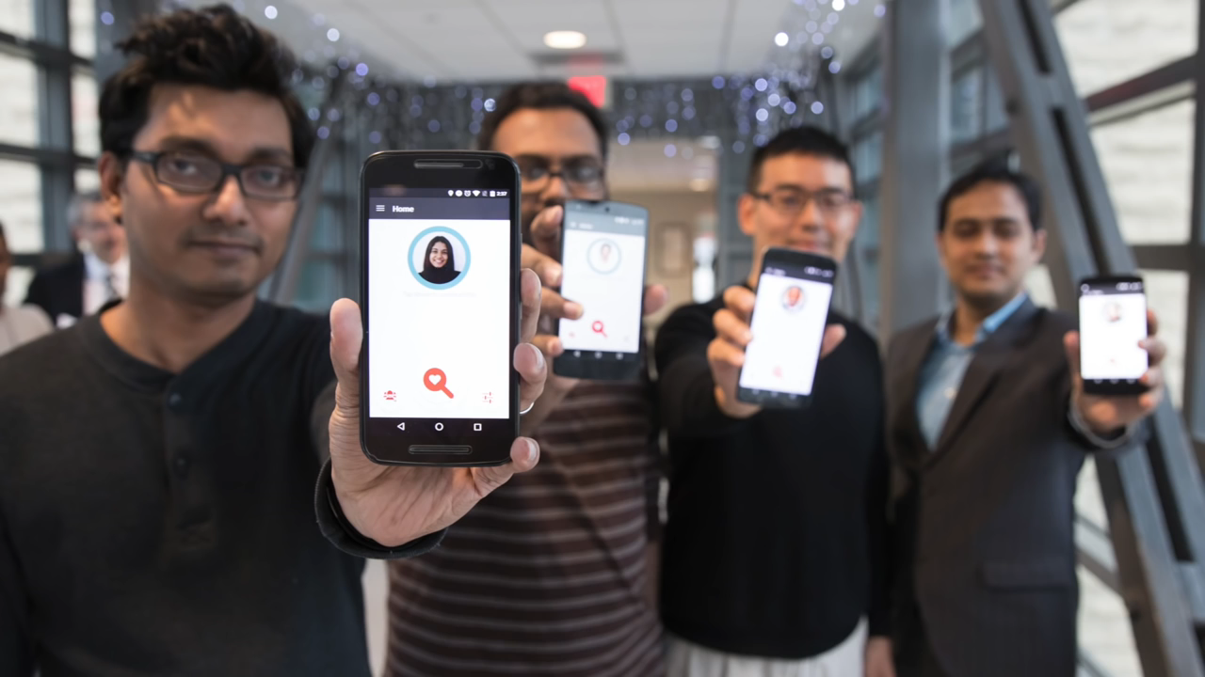
FaceDate Movie

Slide 16
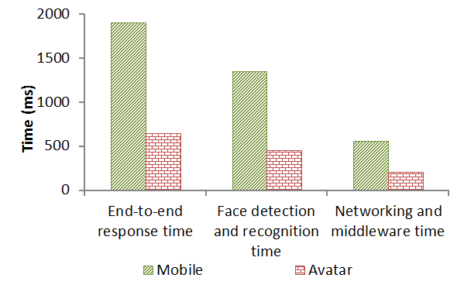
End-to-end Response Time and Power Consumption for LostChild App
Moitree improve latency by up to 3 times compared to mobile only solution for this experiment
Avatar-based implementation of LostChild reduces power consumption by 25 times compared with mobile-only solution

Slide 17
Sentio: Distributed Sensor Virtualization for Mobile-Cloud Apps

Slide 18
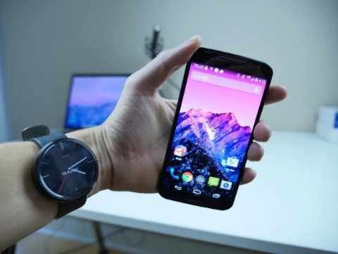
Goal: Mobile Apps Access Distributed Sensors Seamlessly
Mobile apps running on a device may need to
  Access sensors on other devices in real-time (e.g., mobile health, mobile gaming)
    Sensor fusion
    Cross-validation of data
    Choosing “best” sensor when several sensors of same type are available
  Access sensors from cloud when app components are offloaded
Existing mobile sensing frameworks do not provide these features
  Difficult for apps to leverage the collective power of sensors on other devices
  Limited benefits from offloading context-aware apps that need sensor access

Slide 19
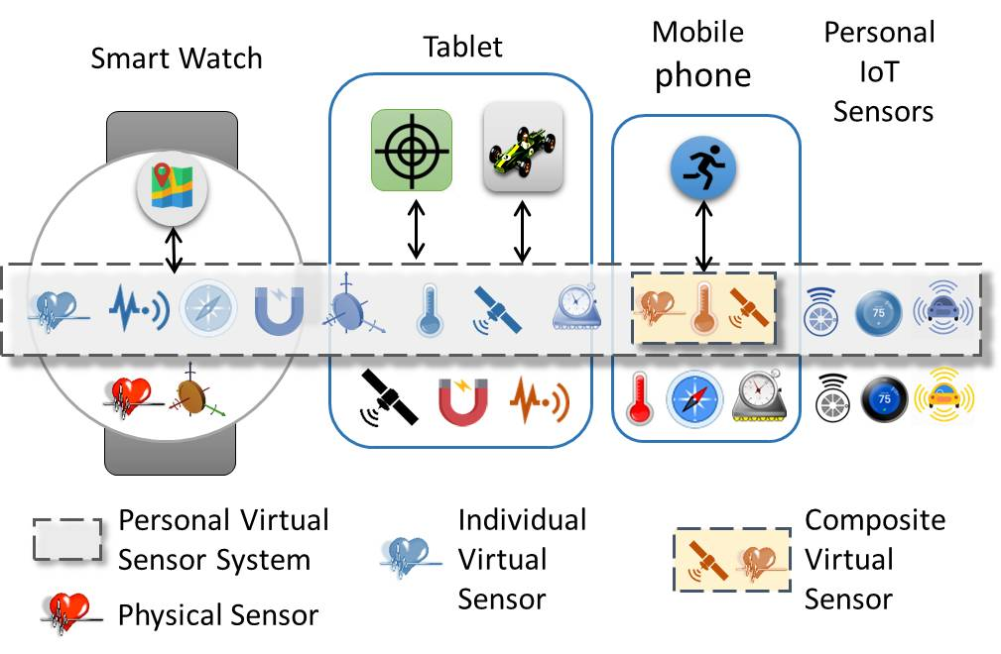
Sentio: High-Level View
Distributed middleware that presents mobile apps with a personal virtual sensor system (PVSS)
PVSS comprises of all available sensors from all devices (mobiles and IoT) belonging to the user running the app
  Public sensors belonging to other entities can become part of PVSS

Slide 20
Sentio: Features
Common API for apps no matter where they run
  Offers support for creating individual and composite virtual sensors
  Provides access to virtual sensors in the same way with access to local sensors
  Allows programmers to specify a sensing mode, and then map the virtual sensor to the most suitable physical sensor for that mode
    Modes: accuracy, real-time, energy efficiency
Middleware hides low-level communication and sensor management
  Supports real-time access to remote sensor data
  Maintains seamless connectivity to the physical sensor even after offloading app components to the cloud
  Adapts to context changes by re-mapping a virtual sensor to a more suitable physical sensor
  Does not require modifications to operating system

Slide 21
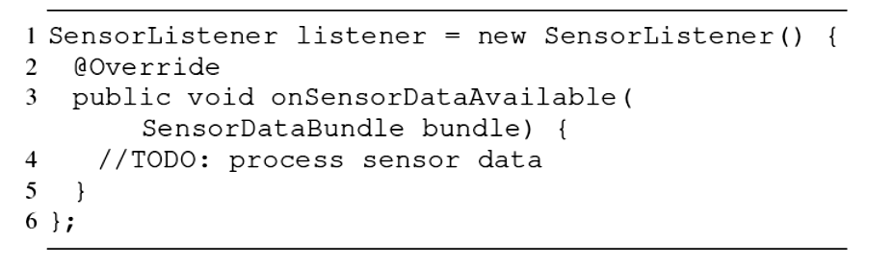
Programming with Sentio’s API
API follows an event-driven and callback-based asynchronous design
For each API function, the app needs to provide a callback function
An API call sends a request and returns immediately
The middleware handles the request and returns the sensing data to the app by invoking the callback function
Implementing a sensor listener callback

Slide 22
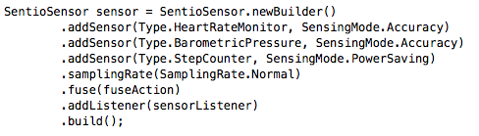
Building a Composite Sensor
Composite sensor for climbing combines readings from:
  Most accurate Heart Rate Monitor and Barometric pressure sensor in PVSS
  Most energy-efficient Step Counter sensor in PVSS
  A custom fuse action is implemented by the programmer
Warn mountain climbers when they should rest or drink more water at high altitude

Slide 23
Middleware Architecture
Distributed middleware: instances run on every participating device
    Manages sensor registration, data collection, sensor mapping
Instance in Avatar maintains global registry and sensor state
  Ad hoc networking is used for failover: primary device (smart phone) periodically synchronizes with the cloud instance to be able to take over in case of failures

Slide 24
Middleware Design

Slide 25
Design Details
Sensor discovery is done during initialization
  Each instance builds local registry
  Cloud instance maintains global registry
If app doesn’t specify a sensing mode, Sentio makes the selection by balancing accuracy, latency, and power
To reduce jitter, rate controller buffers data points arriving early and uses extrapolation to project data points that arrive late
If context changes (e.g., low battery) in sensing provider device
  Instance in provider raises an alert event
  Instance in consumer device re-maps virtual sensor to another suitable sensor

Slide 26
Prototype and Apps
Implemented for Android and Android Wear OS
  3,127 LoC for the SDK
  3,726 LoC for the Android middleware
  561 additional LoC for the Android Wear middleware
Implemented two proof-of-concept apps (SentioApp and SentioFit)
Modified two open source games (Space Shooting and Tilt Control) to use Sentio API
  Only 6 LoC needed to be modified to use remote accelerometer on smart phone or smart watch
Tested using Nexus 6, Nexus 5X, Moto X smart phones and Samsung Gear Live smart watch
Bluetooth and WiFi used for data communication
Android x86 64-bit VM is used as the cloud entity

Slide 27
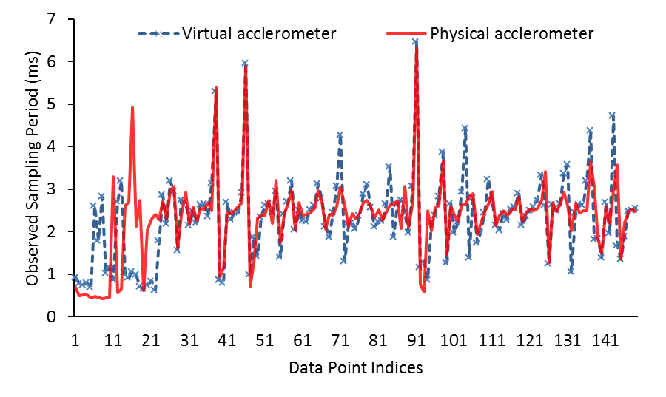
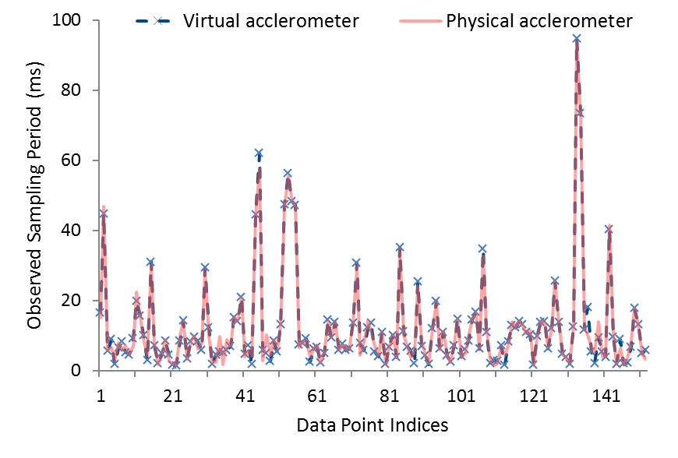
Sentio Overhead
Physical sensor on a phone
Physical sensor on a watch
Measured the difference between the observed sensor sampling period for virtual and physical accelerometer for Space Shooting game
  Metric quantifies Sentio’s overhead
  Communication is done over WiFi
The results show minimal overhead

Slide 28
Sentio Overhead for Offloaded Computation
Measured observed sampling period when Tilt Control game is offloaded to the cloud
Accessing sensors from cloud works well
  The difference in sampling periods is negligible for all sampling rates, except Fastest
  The difference for Fastest is 5.32ms, which is acceptable in most practical situations

Slide 29
OFS: An Overlay File System for Mobile-Cloud Apps

Slide 30
Existing Offloading Systems Cannot Handle
File I/O Efficiently
Some systems don’t support offloading tasks that perform file operations
  COMET [OSDI ’12]
Some other systems lack support for consistent remote file access
  MAUI [MobiSys ’10], ThinkAir [Infocom ’12], CloneCloud [EuroSys ’11], Sapphire [OSDI ’14]
How to provide efficient and consistent file access for offloaded tasks?

Slide 31



Example of Mobile-Cloud App
Photo Enhancement App
1. Take and store a photo
6. Read the processed photo
7. Display the processed photo
3. Read the photo from mobile
5. Update the photo
4. Apply photo enhancement
2. Offload photo enhancement operations to the cloud
Mobile
Cloud
Characteristics of file I/O in cloud-assisted mobile apps:
  Read and write files on both mobile and cloud
  Require strong consistency
  Long I/O latency due to transferring the file over network

Slide 32
File System Requirements for Mobile-Cloud Apps
Location transparency
  Access remote files as though they were local
  Maintain file sessions during task offloading
Consistency
  Ensure correct execution of tasks distributed across mobiles and cloud
Performance
  Provide low latency with little network overhead to save energy and network bandwidth
Ease of deployment
  Require minimal privileges in addition to those needed to run task
  No need to save to-be-accessed files before application runs

Slide 33
OFS at a Glance
Application-level file system
  Doesn’t need system-wide management
  Can work with any native file system
  Doesn’t incur costly context switches
Benefits
  Different levels of consistency (delayed-update policy)
  Location transparency (file session management)
  Low overhead (low latency file access, low overhead consistency maintenance)
  Ease of deployment (application level)

Slide 34
Overall System Architecture
Mobile device
Cloud
Standard file I/O interface
Standard file I/O interface
Mobile app
Offloaded task
Consistency
OFS
OFS
Block buffer
Offloading middleware
Offloading middleware
Block buffer
Block buffer
Block buffer
Local accesses
Local accesses
OFS intercepts and monitors file access requests from tasks in application
OS
OS
Native File System
For remote file access, OFS maintains a block buffer to cache blocks read from remote files through network
Native File System
Unbuffered remote accesses

Slide 35
OFS Architecture Details
Standard file I/O interface to app
Native/OFS Switch
Session management
Interface to task offloading middleware
Buffer management
Consistency management
To other devices
Block buffer
To native file systems

Slide 36
Delayed-Update Consistency Algorithm
Monitor file access pattern to efficiently maintain strong consistency
  Combination of write-invalidate and write-update
  Invalidate duplicates; update them when they are about be to read
Miss
Hit
Hit
Miss
Hit
Miss
Hit
R
R
R
R
R
R
R
Cloud
T
Mobile
w
w
w
w
w
w
w
w
w
w
w
w
w
w
w
Update
Update
Update
Update
Invalidate
Invalidate
Invalidate
Invalidate
Invalidate
Invalidate

Slide 37
OFS Implementation
Implemented in Java on Android OS
Uses an Android-x86 VM to run offloaded tasks
Uses Kryonet, an NIO-based TCP library, for network communication
Decoupled from task offloading systems:
  Increases compatibility with different offloading systems
  Reduces development efforts
Implemented as separate system running a set of Android services
  OFS stub linked into each app to interface between app and OFS

Slide 38
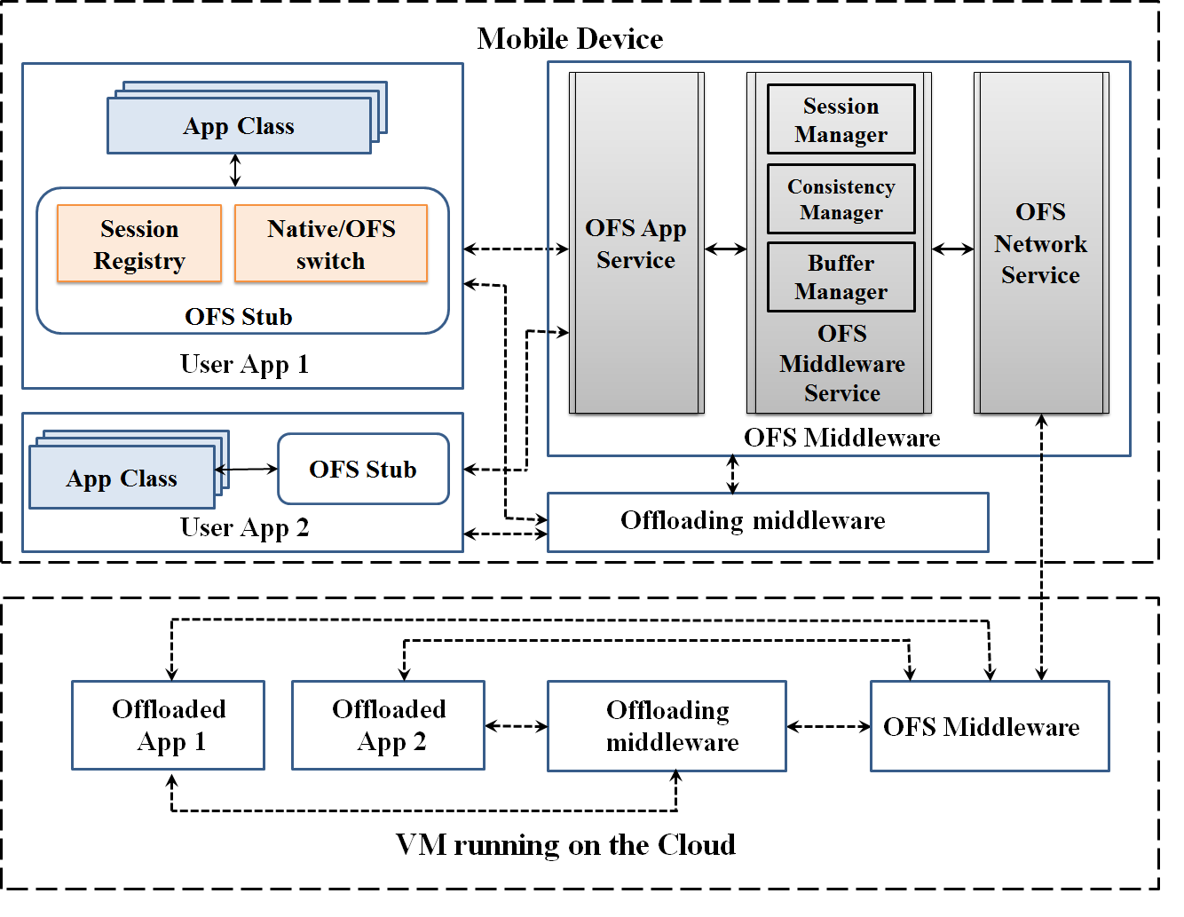
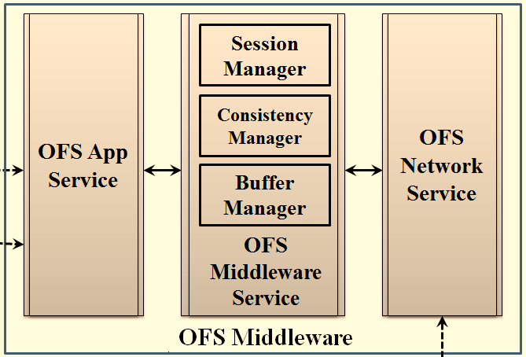
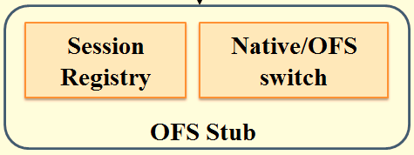
Architecture of OFS Implementation
Upper Layer: OFS Stub
Lower Layer: OFS Middleware

Slide 39


Architecture of OFS Implementation
Intercept I/O requests using AspectJ
Code to analyze I/O requests and to call appropriate methods is injected with the weaving mechanism
Inject the code during compile time
Helps native/OFS switch to filter I/O requests
Manages and updates file status (such as location, open mode, etc.) and data structures for accessing opened files during an active session

Slide 40
Architecture of OFS Implementation
Implemented as a set of sticky application services
Starts automatically when the system is on
Simple check-pointing mechanism is implemented to prevent loss of states and data in case service is killed

Slide 41
Case Study: Photo Enhancement (PE) App
PE-Dropbox does not work
  Have to manually mark the photos available for offline access to be able to download them on mobile
  Photos have to be reopen before reading them the first time in cloud or mobile
  App displays old version of the photo despite newer version being available in the cloud
PE-OFS works well
  With no task offloaded: end-to-end latency increases by less than 0.6% compared to PE-Mobile
  With task offloading:
    End-to-end latency decreases by 43% on average compared to PE-Mobile
    Combined energy consumption of the app and the middleware is decreased by 3% compared to PE-Mobile

Slide 42
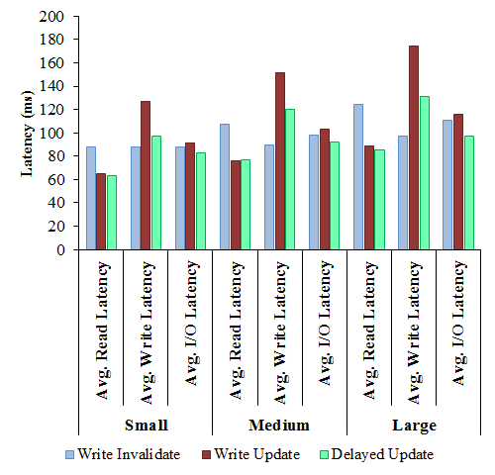
I/O Latency with PE App
29% lower average read latency compared to write-invalidate
23% lower average write latency compared to write-update
8% and 12% lower average I/O latency compared to write-invalidate and write-update policies

Slide 43
Conclusions
We provide system support at 3 layers to enable distributed mobile-cloud app development and deployment
  Programming: Moitree provides a high-level, context-aware, group-based programming model
  Sensing: Sentio provides a unified view of a personal sensing ecosystem through sensor virtualization
  Storage: OFS provides efficiency, consistency, and location transparency for file access
Built prototypes and apps in Android for all these systems and achieved good performance

Slide 44
Lessons Learned
Smart phones and wearable devices create large scale real-life environment for distributed mobile computing
  Mobile + cloud architectures enable novel apps and make existing apps more efficient
    Internet of Things is next (prediction: trillion of devices)
Significant amount of system/networking/algorithm research necessary to support applications in these environments
  Big potential for data analytics over mobile sensing data
  Applications must adapt to context and be robust to sensing errors
Scale, power, privacy, incentives, data reliability: important issues for distributed mobile computing
Testing apps/systems in real-life conditions is a must
  Ideally, at a decent scale as well

Slide 45
Thanks!
http://cs.njit.edu/~borcea/
Acknowledgment:
  NSF Grants No. CNS 1409523 and DGE 1565478
  Students: Hillol Debnath, Nafize Paiker, Mohammad Khan, Jianchen Shan, and Pradyumna Neog
  Colleagues: Reza Curtmola, Xiaoning Ding, Narain Gehani

