Slide 1
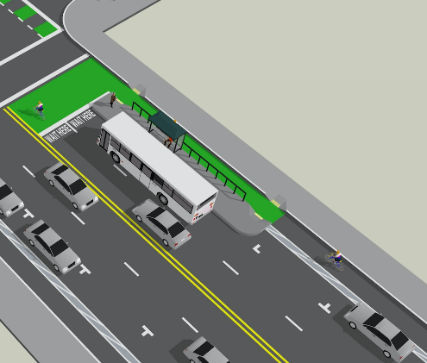
On-The-Fly Curbside Parking Assignment
Abeer Hakeem, Narain Gehani, Xiaoning Ding, Reza Curtmola, Cristian Borcea
^{Department of Computer Science}
New Jersey Institute of Technology

Slide 2
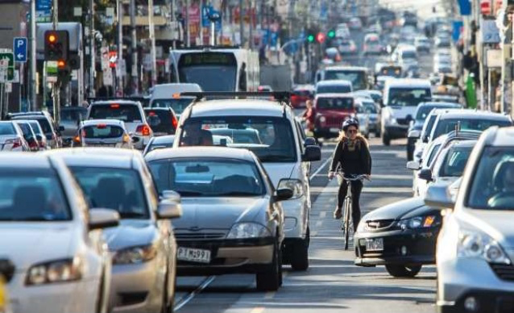
Have You Ever Spent Hours Driving Around the Block for a Free Parking Space?
Many cities rely on free curbside parking spaces to supplement their limited paid parking options
People prefer free curbside parking to save money
Cost of cruising for curbside parking spaces
Billions of hours lost to find available spaces during peak periods
Billions of gallons of gasoline wasted
Air pollution and noise
Traffic congestion and driver frustration

Slide 3
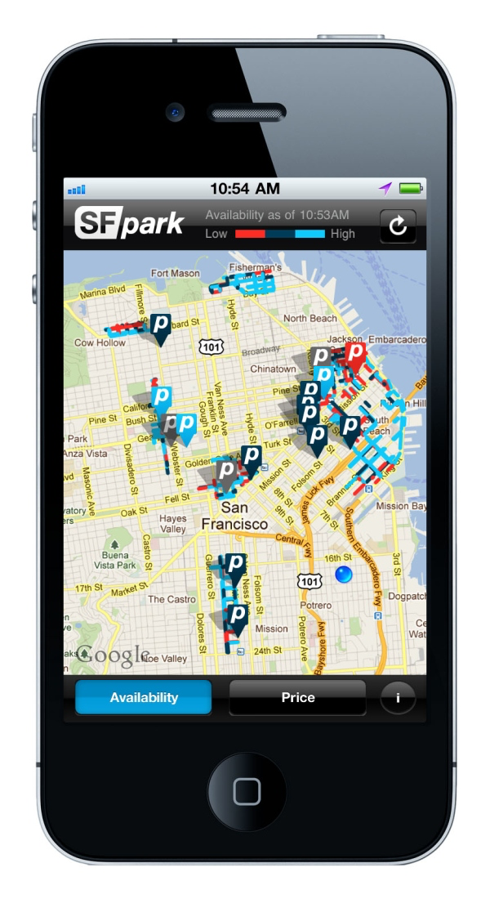
Parking Infrastructure Solutions
Examples
SFpark system spent $23 million to install sensors to cover 25% of the curbside parking spaces
ParkNet system uses vehicles equipped with costly ultrasonic range finders to detect available spaces
Problems with parking infrastructure solutions
Cost
Parking space contention
Higher traffic congestion

Slide 4
What Are We Trying to Achieve?
Design a cost-effective system that guides and assigns drivers to available free parking spaces
Reduce parking space contention and associated traffic congestion
Improve the overall social welfare by optimizing the travel time (driving and walking) as a system wide objective

Slide 5
Outline
Motivation
FPS Design
FPA Algorithm
Evaluation
Conclusion

Slide 6
Free Parking System (FPS)
System for assigning free curbside parking spaces to drivers
Uses novel parking assignment algorithm that optimizes the travel time as a system wide objective
Accepts parking requests on-the-fly
Assumes that not all drivers participate in our system
Receives parking occupancy reports from drivers
Works on smart phones and require no infrastructure on the roads or in the cars

Slide 7
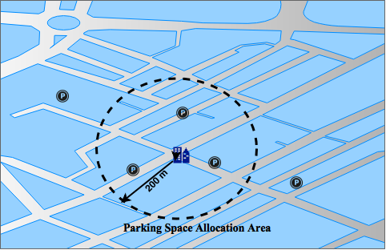
FPS Design
Parking Allocator (PA):
runs on central server
manages the incoming parking
requests
determines the available
parking spaces
PA
Parking Request
PR
Parking Request
Assigned space
Parking Request
PR
PR
Parking Requestor (PR):
runs on driver’s smart phone
submits parking requests
reports parking status to PA
guides driver to the
assigned parking space

Slide 8
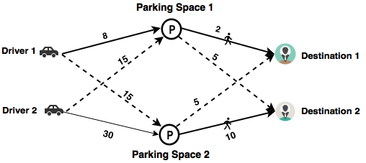
A Strawman Solution for Parking Space Assignment Algorithm
Assignment-1 (Greedy): total time = 50; walking time = 12
Assignment-2: total time = 40; walking time = 10

Slide 9
A Strawman Solution for Parking Space Assignment Algorithm
Greedy strategy may lead to substantial increase in the total travel time

Slide 10
FPA Parking Assignment Algorithm
A dynamic parking assignment algorithm that minimizes the total travel time (walking and driving) for all drivers
min $\sum_{i=1}^{n}{T(v_{i}}$) , n = $\left|V\right|$, $v_{i}∈V$
The algorithm works in two phases
Minimize the total walking time from the parking spaces to the drivers’ destinations by using minimum-cost network flow algorithm
Find assignments ($v_{i}$, $s_{j}$) for all $v_{i}∈V$ s.t. min $\sum_{i=1}^{n}{T_{w}(}s_{j}$, des($v_{i}$)), where $n=\left|V\right|, { s}_{j}∈S$
Minimize the total driving time from the vehicles’ current positions to the parking spaces by using our modified compound laxity algorithm
Assign $v_{k}$ next if $L_{v_{k}}$(t) is min for all $v_{i}∈V$

Slide 11
FPA Parking Assignment Process
Arrival parking Requests
WAIT
4,3,2,1
PA
4,3,2,1
2,1
4,3
Request(1)
Drivers enter allocation area
Request(3)
Request(2)
READY
PR
Request(4)
3
PR
Select request with critical laxity
4
ASSIGNED
Un-successful assignment
Parking Spaces Allocated

Slide 12
FPA Parking Assignment Process
for each vehicle i, compute the estimated
driving time to its destination
$D(C_{i} ,des(v_{i})$)
Arrival parking Requests
WAIT
1,2
Drivers enter allocation area
pre-allocate the closest
available parking space
READY
Allocation
conflict?
4,3
Conflict
3
Select request with critical laxity
Identify the best
minimum walking time and
the corresponding allocation
No conflict
Update the laxity
ASSIGNED
Un-successful assignment
Calculate the laxity $L_{v_{i}}$(t) of
each vehicle i
$$min⁡(D\left(C_{i},s_{j}\right), D\left(C_{i}, des\left(v_{i}\right)\right))$$
Parking Spaces Allocated
4
Find vehicle i with minimum
laxity (critical)

Slide 13
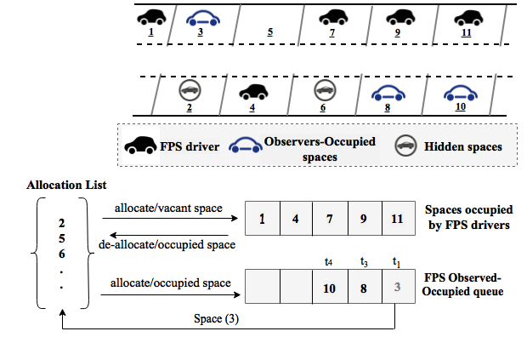
FPA-1 Algorithm
An enhanced version of FPA that considers the spaces occupied by unsubscribed drivers

Slide 14
Outline
Motivation
FPS Design
FPA Algorithm
Evaluation
Conclusion

Slide 15
Experiments
Goal: evaluate the performance of FPA and FPA-1 against Naïve and Greedy solutions
Naïve: assumes a breadth-first-search for parking spaces around the destinations
Greedy: moves each vehicle toward the closest available space to its destination
Performance Metrics
Average travel time among all drivers
Gain/Loss ratio per driver

Slide 16
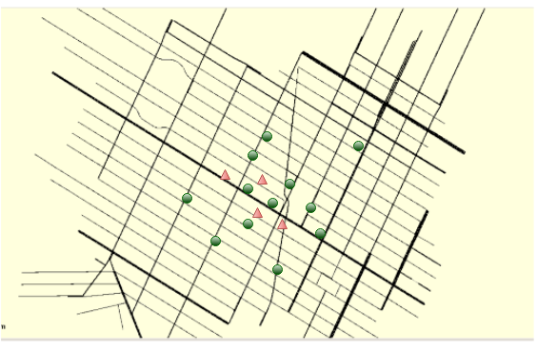
Simulation Setup
SUMO simulation
Origins and the destinations of vehicles are randomly chosen
Each vehicle moves at the legal speed limit of each road
1024 parking spaces
400 destinations
Destinations
Parking spaces
Road network map: Manhattan, New York City

Slide 17
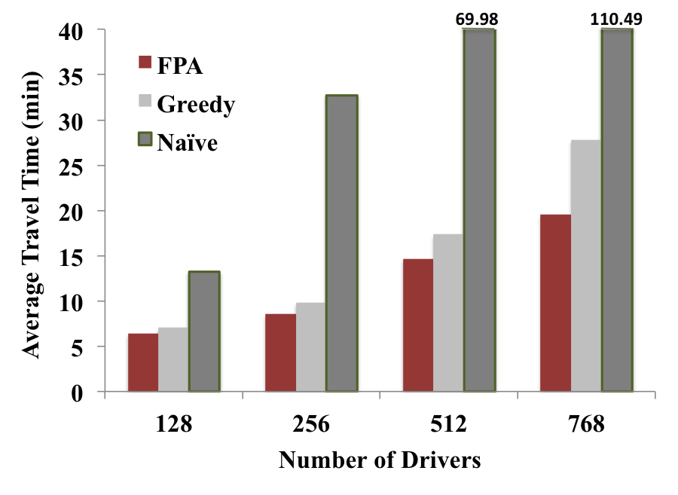
Average Travel Time: Subscribed Drivers (1)
8 destinations
FPA decreases the average travel time by
Up to 4x compared to Naïve solution
40% compared to Greedy

Slide 18
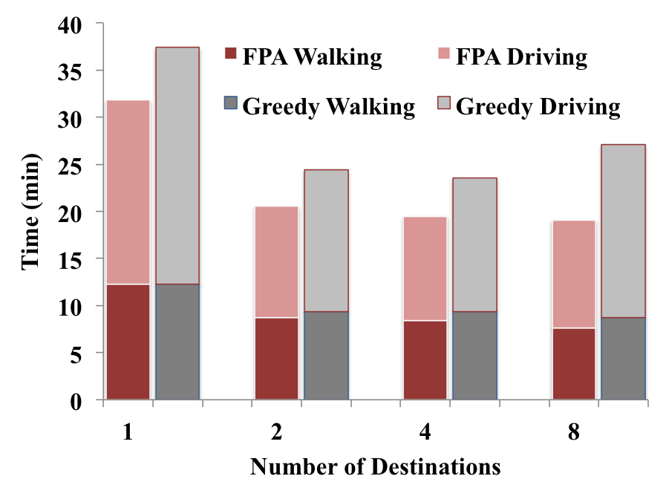
Average Travel Time: Subscribed Drivers (2)
768 drivers
FPA decreases the average travel time by as much as 42% for 8 destinations, compared to Greedy
Average driving time decreases by as much as 61%
Average walking time decreases by as much as 14%
FPA’s advantage becomes more prominent for more destinations

Slide 19
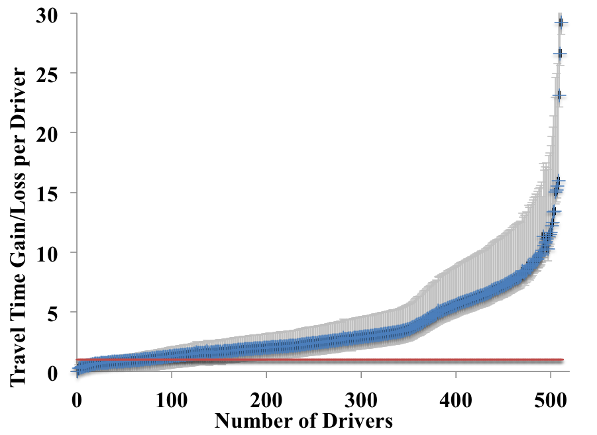
Travel Time Gain/Loss for All Drivers
Gain: ratio > 1
Loss: ratio < 1
8 destinations
=1
Travel Time Gain/Loss Ratio = Ti(Naïve)/Ti(FPA)
87.8% of FPS drivers obtain gains
We plan to investigate methods to limit the number of drivers who experience losses and to bound the value of losses

Slide 20
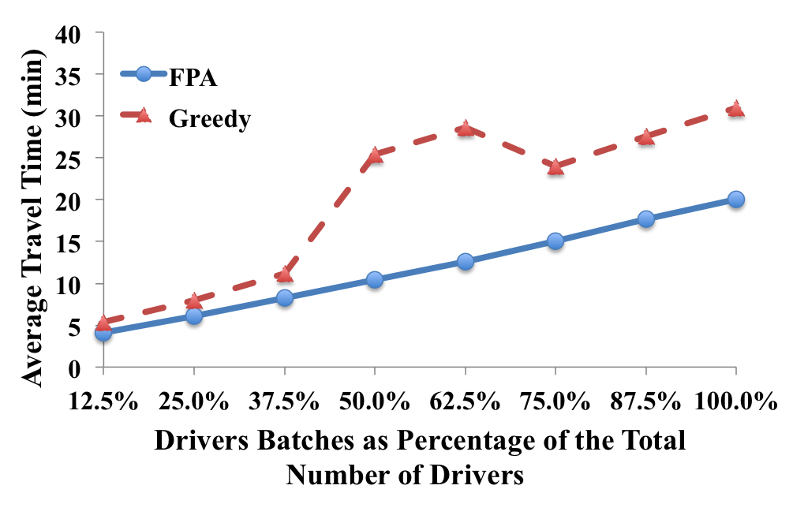
FPS Consistency over Time
768 drivers and
8 destinations
FPA performs consistently better than Greedy
FPA achieves best performance in the middle batches

Slide 21
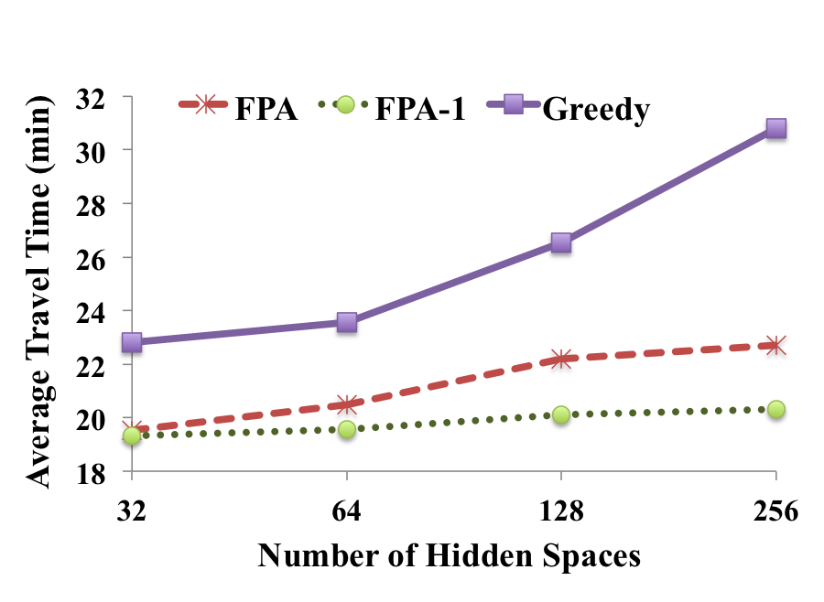
Average Travel Time: System with Un-subscribed Drivers
768 drivers and
8 destinations
FPA and FPA-1 outperform Greedy
FPA-1 achieves the best performance
Reduces the average travel time by 10% relative to FPA and 33% relative to Greedy on average

Slide 22
Conclusions
FPS is a cost-effective and adaptive system for finding free parking spaces
FPA parking assignment algorithm minimizes the total travel time among all drivers
FPA-1 incorporates the effect of unsubscribed drivers on the parking assignment
Both FPA and FPA-1 achieve substantially better performance compared to the other solutions

Slide 23
Acknowledgment
NSF Grants No. CNS 1409523, CNS 1054754, DGE 1565478, DUE 1241976, and SHF 1617749
NSA Grant H98230- 15-1-0274
DARPA/AFRL Contract No. A8650-15-C-7521
http://cs.njit.edu/~borcea/avatar

Slide 24
Backup Slides

Slide 25
Related Work (1)
Parking availability detection and estimation
B. Xu et al., S.Nawaz et al., A.Nandugudi et al.
These solutions use GPS/accelerometer sensors, WiFi beacons, and activity recognition for available parking space detection
FPS targets a different problem
Parking information sharing
O. Wolfson et al., V. Verroios et al., T. Delot et al.
These systems cannot avoid parking space contention
FPS is capable to reduce parking space contention

Slide 26
Related Work (2)
Parking space assignment algorithms based on differential pricing
D. Mackowski et al. developed a demand-based real-time pricing model to allocate parking spaces in urban centers
FPS works with free spaces and does not require any pricing data
D. Ayala et al. developed an offline pricing model for curbside parking
FPS handles a dynamic parking space assignment
Y.Geng et al. developed a real-time pricing model to for parking garages and does not consider the cost of total travel time
FPS works on free curbside parking and uses both walking and driving time as primary factors in its parking assignment algorithm
Parkarr: crowd-sourced parking application
Cannot address the problem of high parking space contention
FPS is capable to reduce parking space contention

